Slide 1
DeepMIMO: A Generic Deep Learning Dataset for Millimeter Wave and Massive MIMO Applications
By Falade Oluwaseun

Slide 2
Introduction
Millimeter wave (mmWave) and massive MIMO are key enabling technologies for current and future wireless systems.
Massive MIMO employs large numbers of antennas, while mmWave refers to higher frequency radio bands ranging from 24GHz to 40GHz, designed to offer much faster data speeds to support highly mobile users (Humans or vehicles).

Slide 3
AIM
To use a supervised learning approach to extract features of the environment and to learn how to use them to predict mmWave and massive MIMO beams.
We can have control over the system setup and the antenna configuration by specifying the:
Number of active users to activate a certain group of users for the DeepMIMO dataset generation code.
Number of Base Station antennas to activate a certain group of BS antennas for the DeepMIMO dataset generation code.

Slide 4
Dataset description
The authors propose comparison of algorithms through a common dataset can be used to reproduce results through adjustments of channel parameters[1]
This dataset scenario has 18 base stations and more than one million users, which generates a sufficiently large dataset.
We use the DeepMIMO dataset to construct the inputs/outputs of the model and generate the mmWave beam prediction results using machine learning.
My project is based on received signal strength indicators (RSSI), where only the amplitude of the received dataset, is fed to the neural network model

Slide 5
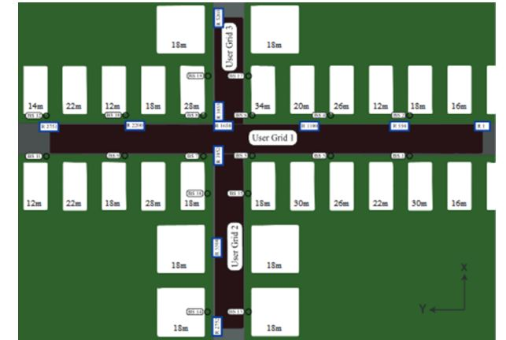
Figure 1: 01_60GHz RayTracing Scenario used[1]

Slide 6
METHODOLOGY
Step1: I downloaded the Ray tracing dataset the files necessary to create the source code algorithm folder and scenario (60GHz - 01-scenario) available on the author site (Deepmimo.net)
Step2:Set the following Channel parameters stated by the authors of Deepmimo for the “01” scenario which are:

Slide 7
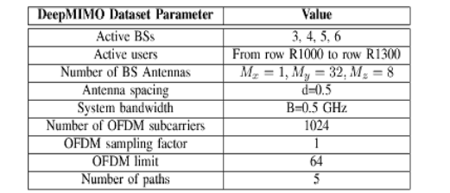
Fig 2: Channel parameters for each transmitter / receiver pair[1]

Slide 8
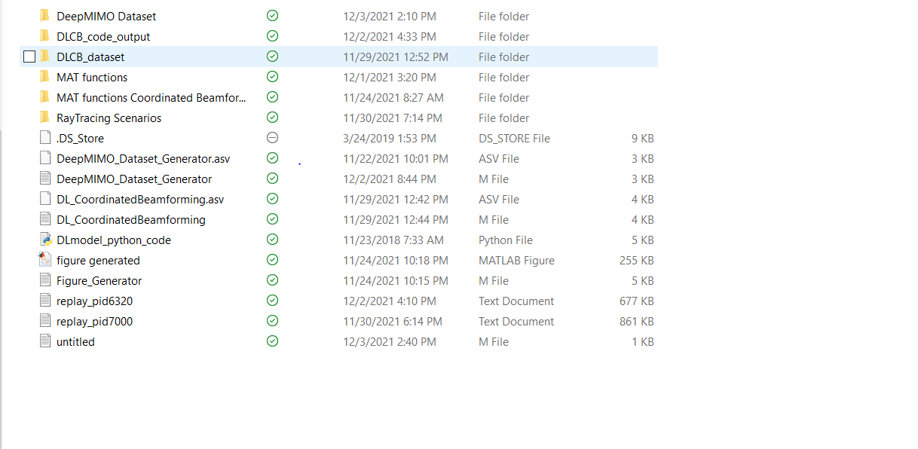
Figure 3: Files in the DeepMIMO folder

Slide 9
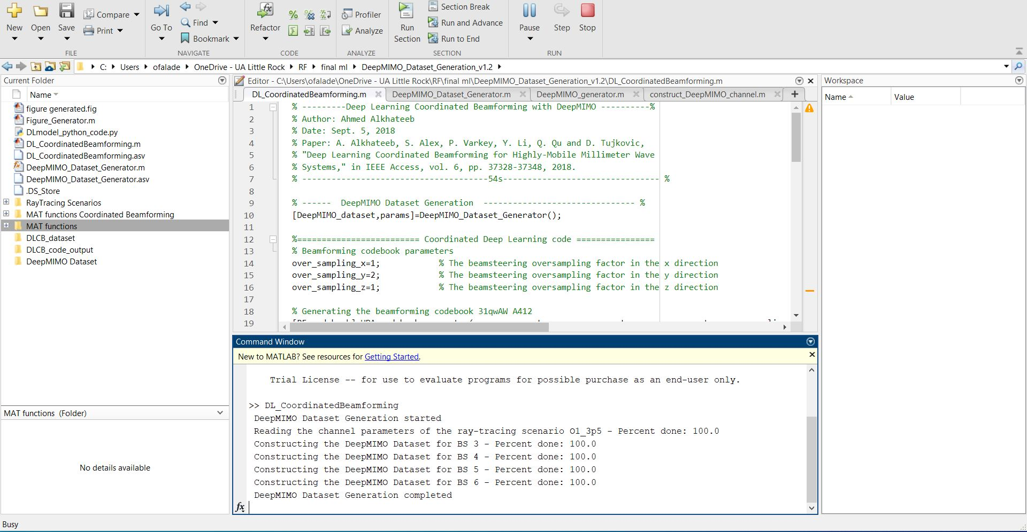
Step 3: After setting up the channel parameters, I ran the Dataset generation code. A file called Dataset.mat with 546,000 datapoints was produced(Amplitude and Phase).
Step 4: Once you have created the dataset run the DL model beamforming.mat code to generate the DL model (DLinput.mat and DLoutput.mat) which only contains the amplitude.
Figure 4: MATLAB Environment

Slide 10
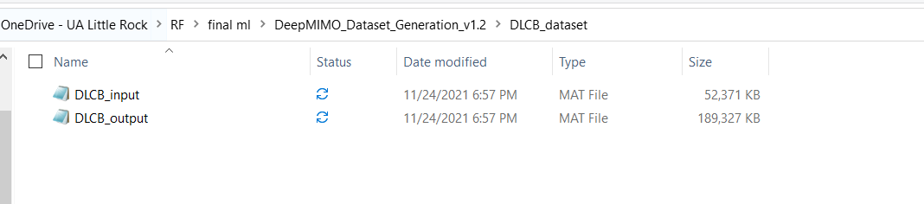
Figure 5:DL model beamforming.mat code generated the DL model (DLinput.mat and DLoutput.mat).

Slide 11
Step 7: The neural network model has 4 fully connected layers. The fully-connected layers use ReLU activation units and every layer had drop-out layer with dropout rate of 0.5%.
Tensorflow framework inside Jupyter notebook was used to build, train and test your model. I ran DL model (DLinput.mat andDLoutput.mat) placed in the DLCB_code_output folder.

Slide 12
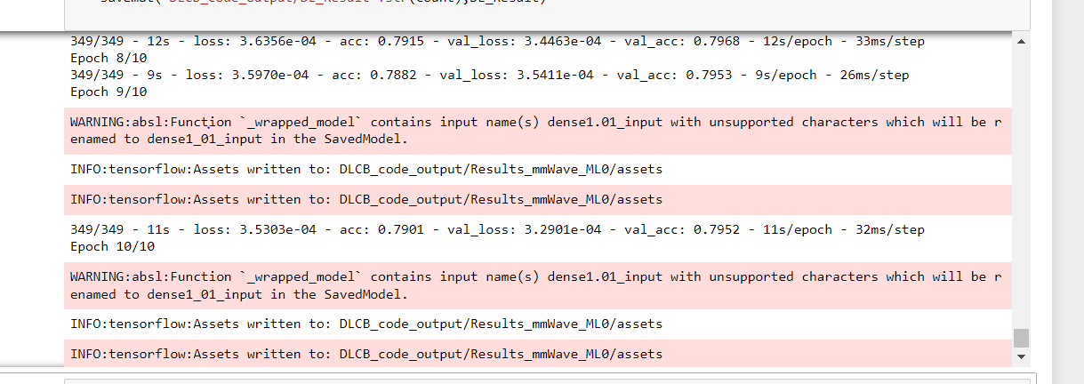
Figure 6: Jupyter notebook Environment

Slide 13
DLCB_code_output folder had the result files inside
Step 8: The Deep learning result files were converted to a .mat and sent to Matlab to be read by the figure_generator.m source code file.

Slide 14
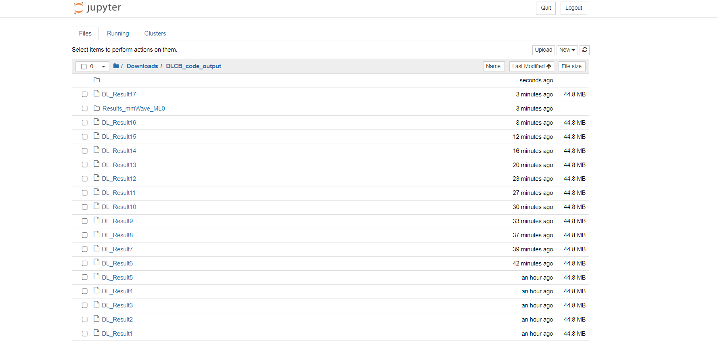
Figure 7: The Deep learning result files

Slide 15
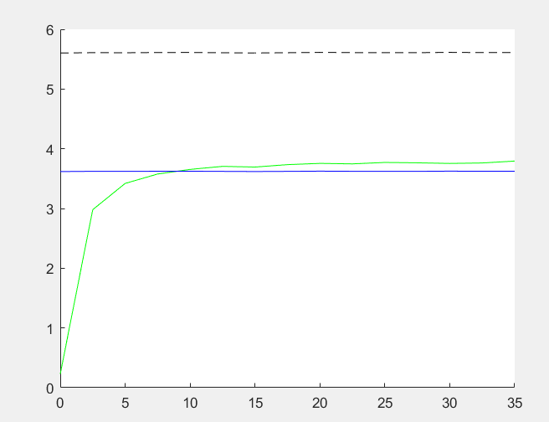
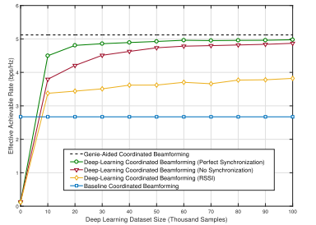
This result is very useful for practical implementations as it means that the phase synchronization may not be needed to learn coordinated beamforming if large enough datasets are adopted
Figure 8,9: The x-axis is the size of the dataset, as it increases the model becomes more accurate and is able to reach and surpass the baseline coordinated beamforming solution[1].

Slide 16
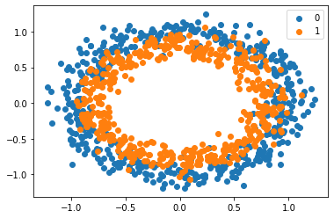
Figure 10 : Visualizing the predicted beamforming vectors vs real measurements

Slide 17
Challenges
I had to re-learn how to work inside MATLAB
It was necessary to understand the adjustments being made as the entire generation process revolves around the parameters being set.
Once the parameters and model were generated using the “01” scenario ray tracing data, which is (64Gb) ,the resultant dataset was saved inside MATLAB in the V.7 format
I had to download each files from the internet (each was 43Mb, 17 in total)
Each file had to be converted to mat file format, before the graphs could be used inside MATLAB
The major challenge is that beam training takes computation time and it would not be advisable to use it in a dynamic environment(Extremely fast cars).
I had to edit the source codes as they were created in 2018.

Slide 18
Conclusion
In conclusion, I think machine learning and deep learning tools can take advantage of the vast amount of data available in mmWave and large MIMO systems and use them to predict beamforming vectors accurately and other project applications.
The output of deep learning will be simplified and reliable [1].
I believe other efficient deep learning algorithms can be used to improve the accuracy of beamforming prediction.
Fig. 8 shows that the machine learning model can learn well with no phase synchronization, both the baseline and the deep-learning coordinated beamforming solutions
It also shows that RSSI in deep-learning coordinated beamforming, still achieves a reasonable gain over the baseline coordinated beamforming solution.
From past simulations, It has shown that to achieve accurate and precise learning, but synchronization is needed in the downlink for optimum accuracy.

Slide 19
References
Alkhateeb, Ahmed, Sam Alex, Paul Varkey, Ying Li, Qi Qu, and Djordje Tujkovic. "Deep learning coordinated beamforming for highly-mobile millimeter wave systems." IEEE Access 6 (2018):37328-37348.
Alkhateeb, Ahmed. "DeepMIMO: A generic deep learning dataset for millimeter wave and massive MIMO applications." arXiv preprint arXiv:1902.06435 (2019).
Singh, Manjit, and Hisham A. Kholidy. "? Generic Datasets, Beamforming Vectors Prediction of 5G Cellular Networks." (2020).
Viriyasitavat, Wantanee, Mate Boban, Hsin-Mu Tsai, and Athanasios Vasilakos. "Vehicularcommunications: Survey and challenges of channel and propagation models." IEEE Vehicular Technology Magazine 10, no. 2 (2015): 55-66.

Slide 20
Thank you!

